Slide 1
YZone App
Program Execution, Governance & Assessment Platform (NiFo Module)
-Chandru
-Geetharani
-Gokila
-Gowrisankar
-Madhankumar

Slide 2
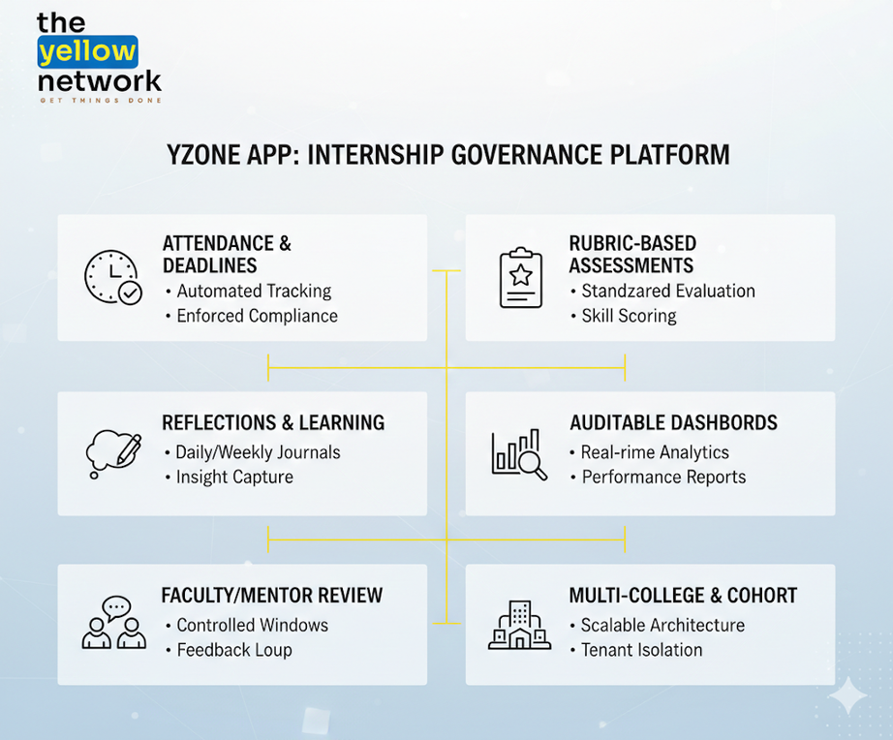

PURPOSE
The purpose of the Yzone App is to bridge the gap between engineering education and industry readiness by enabling students to learn through real-world problem solving, disciplined execution, and continuous reflection within a structured internship environment.
OBJECTIVE
The objective of the Yzone App is to build a scalable, multi-tenant internship governance platform that enforces attendance and deadlines, captures daily and weekly reflections, enables controlled faculty/mentor review windows, performs rubric-based assessments, and generates auditable dashboards and reports across multiple colleges and cohorts.

Slide 3
FUNCTIONAL REQUIREMENT
  Multi-Tenant & Cohort Governance
  Role-Based Access Control (RBAC)
  MoU & Governance Management
  Application & Selection Workflow
  Wild-Card Admission (Facilitator/Exec Only)
  Curriculum & Session Management
  Attendance Tracking (Facilitator Only)
  Daily Progress Tracker + Weekly Reflection
  Controlled Review Windows
  Badges & Leaderboard
  WhatsApp Notifications
  Certificates & Reports

Slide 4
NON-FUNCTIONAL REQUIREMENT
  Performance
  Reliability & Availability
  Security
  Data Isolation (Multi-Tenancy)
  Compliance & Data Retention
  Scalability
  Auditability & Traceability
  Usability & Accessibility
  Branding Standardization

